Slide 1


POST SYNTHESIS TREATMENT OF CsPbBr₃ NANOCRYSTALS TO ENHANCE PHOTOLUMINESCENCE
UNDER THE SUPERVISION OF
Dr. MURALI BANAVOTH
Presented by
Amit Naskar
20CHMS66

Slide 2
Outline
Introduction
Essentials for efficient LEDs
Perovskites
Synthesis procedure
Results and discussion
Conclusion
1
2
3
4
5
6

Slide 3
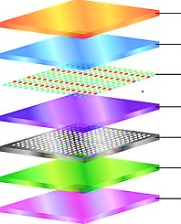
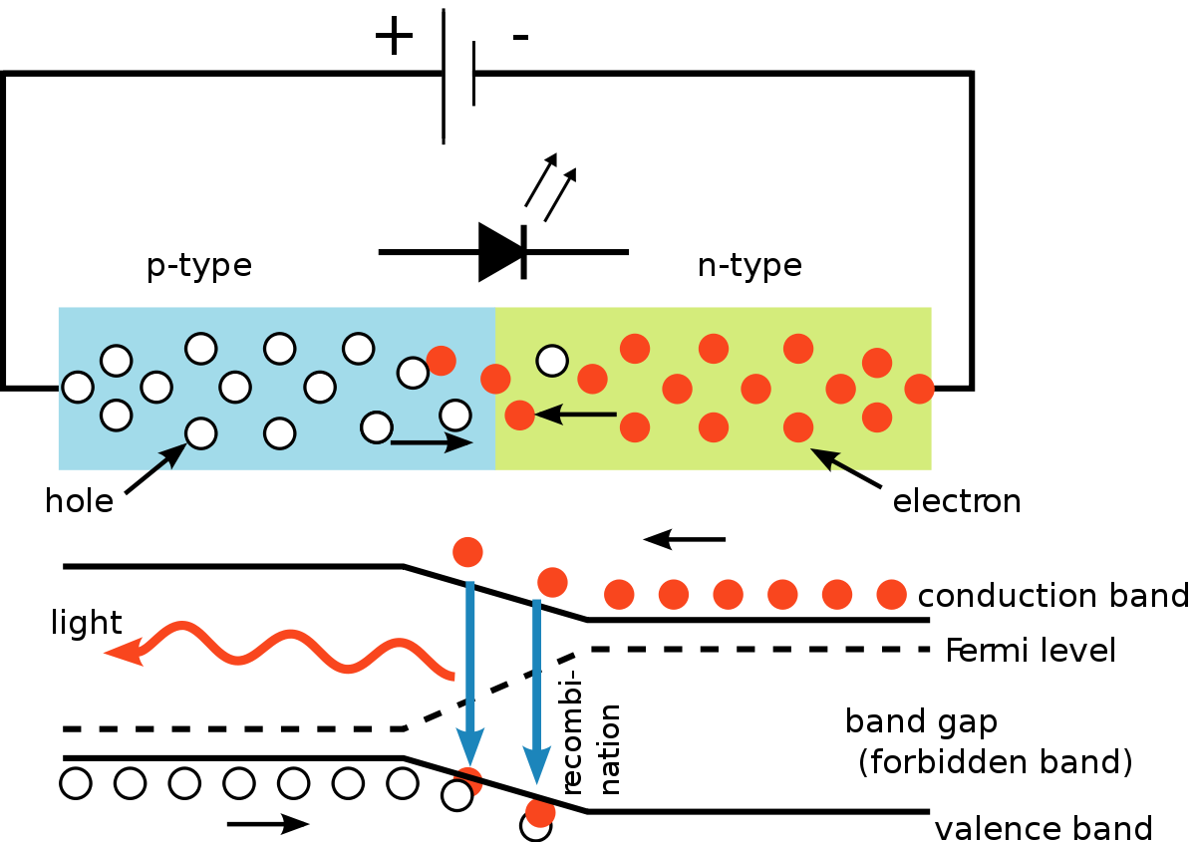
Introduction
LEDs convert electricity directly into photons of light, instead of the wasteful mixture of heat and light.
Advantages of using LEDs
LEDs produce more light per watt
LEDs can emit light of an intended color without the use of color filters.
LEDs can have a relatively long life.
Cathode
ETL
Emission layer
HTL
HIL
Anode
Substrate

Slide 4
Essentials for efficient LEDs
Direct band gap semiconductor
1
2
Optical confinement
Carrier confinement
3
Higher internal quantum efficiency
4
Higher external quantum efficiency
5
Brighter and efficient LEDs

Slide 5
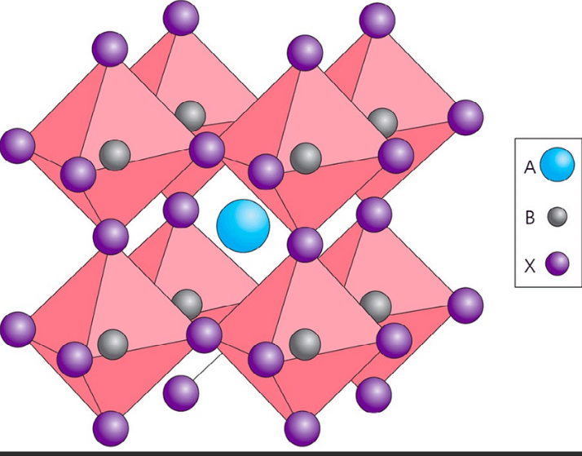
Perovskites
Why perovskites?
Halide perovskite’s crystal structure has a general chemical formula ABX3 where A is a monovalent cation, B is a divalent metal cation and X is a monovalent anion (mostly halide).
The B-site elements octahedrally coordinated with halides to form BX6 inorganic frameworks.
The A components occupy the cuboctahedral cavity formed by nearest-neighbor X atoms in AX12 polyhedrons.
Striking Photovoltaic and optoelectronic properties
High absorption coefficients
Defect tolerance
high photoluminescence quantum yield (PLQY)
diversified dimensions such as nanocrystals (NC), nanowires, 2D layers, quasi 2D, and bulk 3D
This Photo by Unknown Author is licensed under CC BY-SA

Slide 6
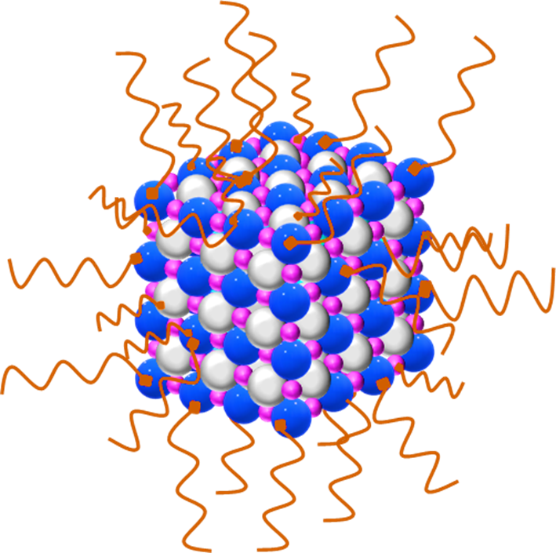
Perovskites Nanocrystals
Why perovskites?
Nanosized crystals of perovskites exhibit quantum-confinement effects that can be exploited to tune the optical properties much like in other semiconductors.
The structural dimensionality of perovskites is easily tunable from 3D to 0D using long-chain alkylammonium cations in their synthesis
Photoluminescence QY
Size tunable band gaps
High color purity
Suppressed defect formation
Low non-radiative recombination
This Photo by Unknown Author is licensed under CC BY-SA

Slide 7

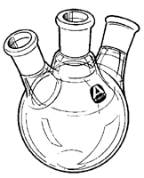

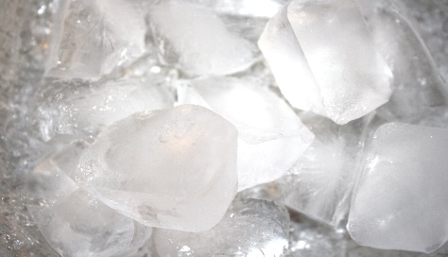


Synthesis Procedure
PbX2+ODE+OLA +
OA+TOP
X=I,Cl,Br
Oleyamine(OLA),
1-Octadecene (ODE),
Tri-n-octylphosphine(TOP)
Cs-oleate
solution
5 seconds
Cool the reaction mixture in ice-water bath
Dry under vacuum for 1 hr at 120 °C, and then heat under N₂ at 120 °C
Maintained at 170°C temperature for 5 minutes and add Cs-oleate

Slide 8
Results and Discussion
Initially CsPbI3,CsPbBr3 and,CsPbCl₃ NCs were synthesized with the standard synthesis procedure.
However, due to the high sensitivity of CsPbI₃ and CsPbCl₃ NCs to temperature, radiation, and humidity they have undergone ligand loss and the phase transformation which eventually led to the loss of their luminescence within a short duration.
Therefore, we considered only CsPbBr₃ NCs further and synthesized GuSCN(5%): CsPbBr₃ NCs along with the pristine CsPbBr₃ NCs by including GuSCN salt in the reaction mixture.
Then the crude NCs were washed using toluene and then stored in toluene for charcterizations.
In UV- Vis absorption spectra, both the absorption spectra are broad
λ_{max} for CsPbBr₃ NCs and GuSCN(5%): CsPbBr₃ NCs are 505 nm and 507 nm
In the case of PL, the emission peaks for CsPbBr₃ NCs and GuSCN(5%): CsPbBr₃ NCs are 510 nm and 514nm, respectively.
Uv-Vis absorption spectra
for CsPbBr3 NCs
Uv-Vis absorption spectra forGuSCN(5%):CsPbBr3 NCs

Slide 9
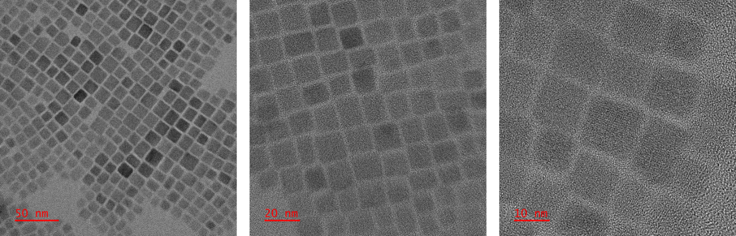
Transmission Electron Microscopy (TEM) images of CsPbBr3 NCs
From the TEM images we confirmed the narrow distribution of the NCs sizes that are in the range of 13 nm to 16 nm, which promotes pure color emission.

Slide 10
Post synthesis treatment
CsPbBr₃ NCs were chosen to perform post-synthesis treatment utilizing various passivating agents that include
YCl₃ PDABr₂ GuSCN KSCN Choline Bromide NH₄SCN
Herein, we added 0.25, 0.5, 0.75, 1.0, 1.25, 1.5, 1.75, 2.0, 2.25 millimoles of each compound individually to the pristine CsPbBr₃ NCs. and investigated the change in photoluminescence that could demonstrate the surface modifications happened to the NCs.

Slide 11
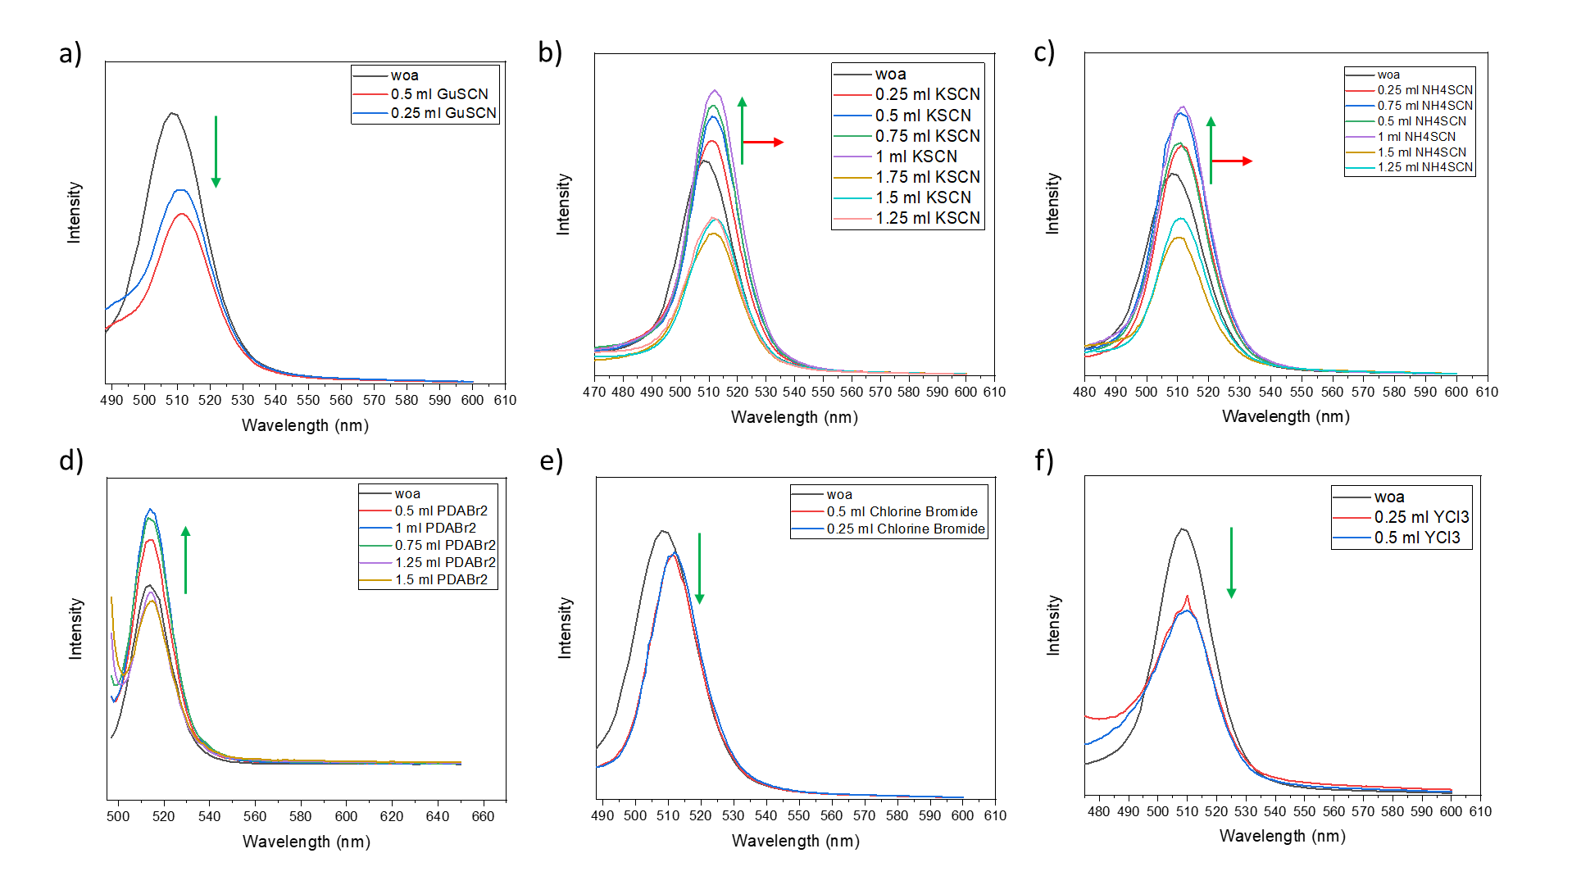
Among all the molecules, PDABr2, KSCN, and NH4SCN have enhanced the emission intensity by 40% approximately may be due to compatible vacant site passivation on the NCs surface.
In the case of KSCN and NH4SCN slight peak shift was observed while no peak shift was observed for PDABr2, which can be attributed to the halide and pseudo halide involvement there

Slide 12
Conclusion
CsPbI3,CsPbBr3 and,CsPbCl3 NCs were synthesized with the standard synthesis procedure
Due to the high sensitivity of CsPbI3 and CsPbCl3 NCs to external stimuli, they have undergone ligand loss and the phase transformation which eventually led to the loss of their luminescence within a short duration.
We considered only the CsPbBr₃ system for the further studies
CsPbBr3 NCs were chosen to perform post-synthesis treatment utilizing various passivating agents to the pristine CsPbBr3 NCs. and investigated the change in photoluminescence that could demonstrate the surface modifications that happened to the NCs.
PDABr2, KSCN, and NH4SCN have enhanced the emission intensity by 40% approximately
In the case of KSCN and NH4SCN slight peak shift was observed that can be attributed to the halide sites on the surface, wherein PDABr2 bromide is the common anion in the perovskite lattice and the passivating agent, whereas in other both cases pseudo halide SCN¯ was involved which is less electronegative compared to the bromide.

Slide 13
ACKNOWLEDGEMENT
I owe my sincere thanks and most profound sense of gratitude to Dr. MURALI BANAVOTH for his guidance, critical suggestions and constant encouragement throughout this project work. I thank all the faculty members of the school of chemistry for their inspiring lectures.
My sincere thanks to Prof. ASHWINI NANGIA, Dean, School of chemistry and past Deans of the School for providing the facilities to carry out research work and all the school faculty members for their help at various times during the course of this work. I also thank all my teachers, who have guided me up to this stage.
I specially thank to Ranadeep Raj S for his help during my project tenure. I also thank Mr. R. Santhosh, Mr. K. Ravi, Ms. Sarvani Jowhar Khanam and Mr. S. Ramu Naidu for their help and encouragement.
I thank my parents for their support and encouragement. Finally, I would like to thank all my classmates and friends for their helping hangs during my course.

Slide 14


